Slide 1
Discussion

Slide 2
This morning
A brief practical introduction to the
Core concepts
Key assumptions
Different statistical methods
used to evaluate the causal effects of policy interventions
Disclaimer:
We took a “wide” instead of “deep” view
Many details / extensions / advanced topics omitted!

Slide 3
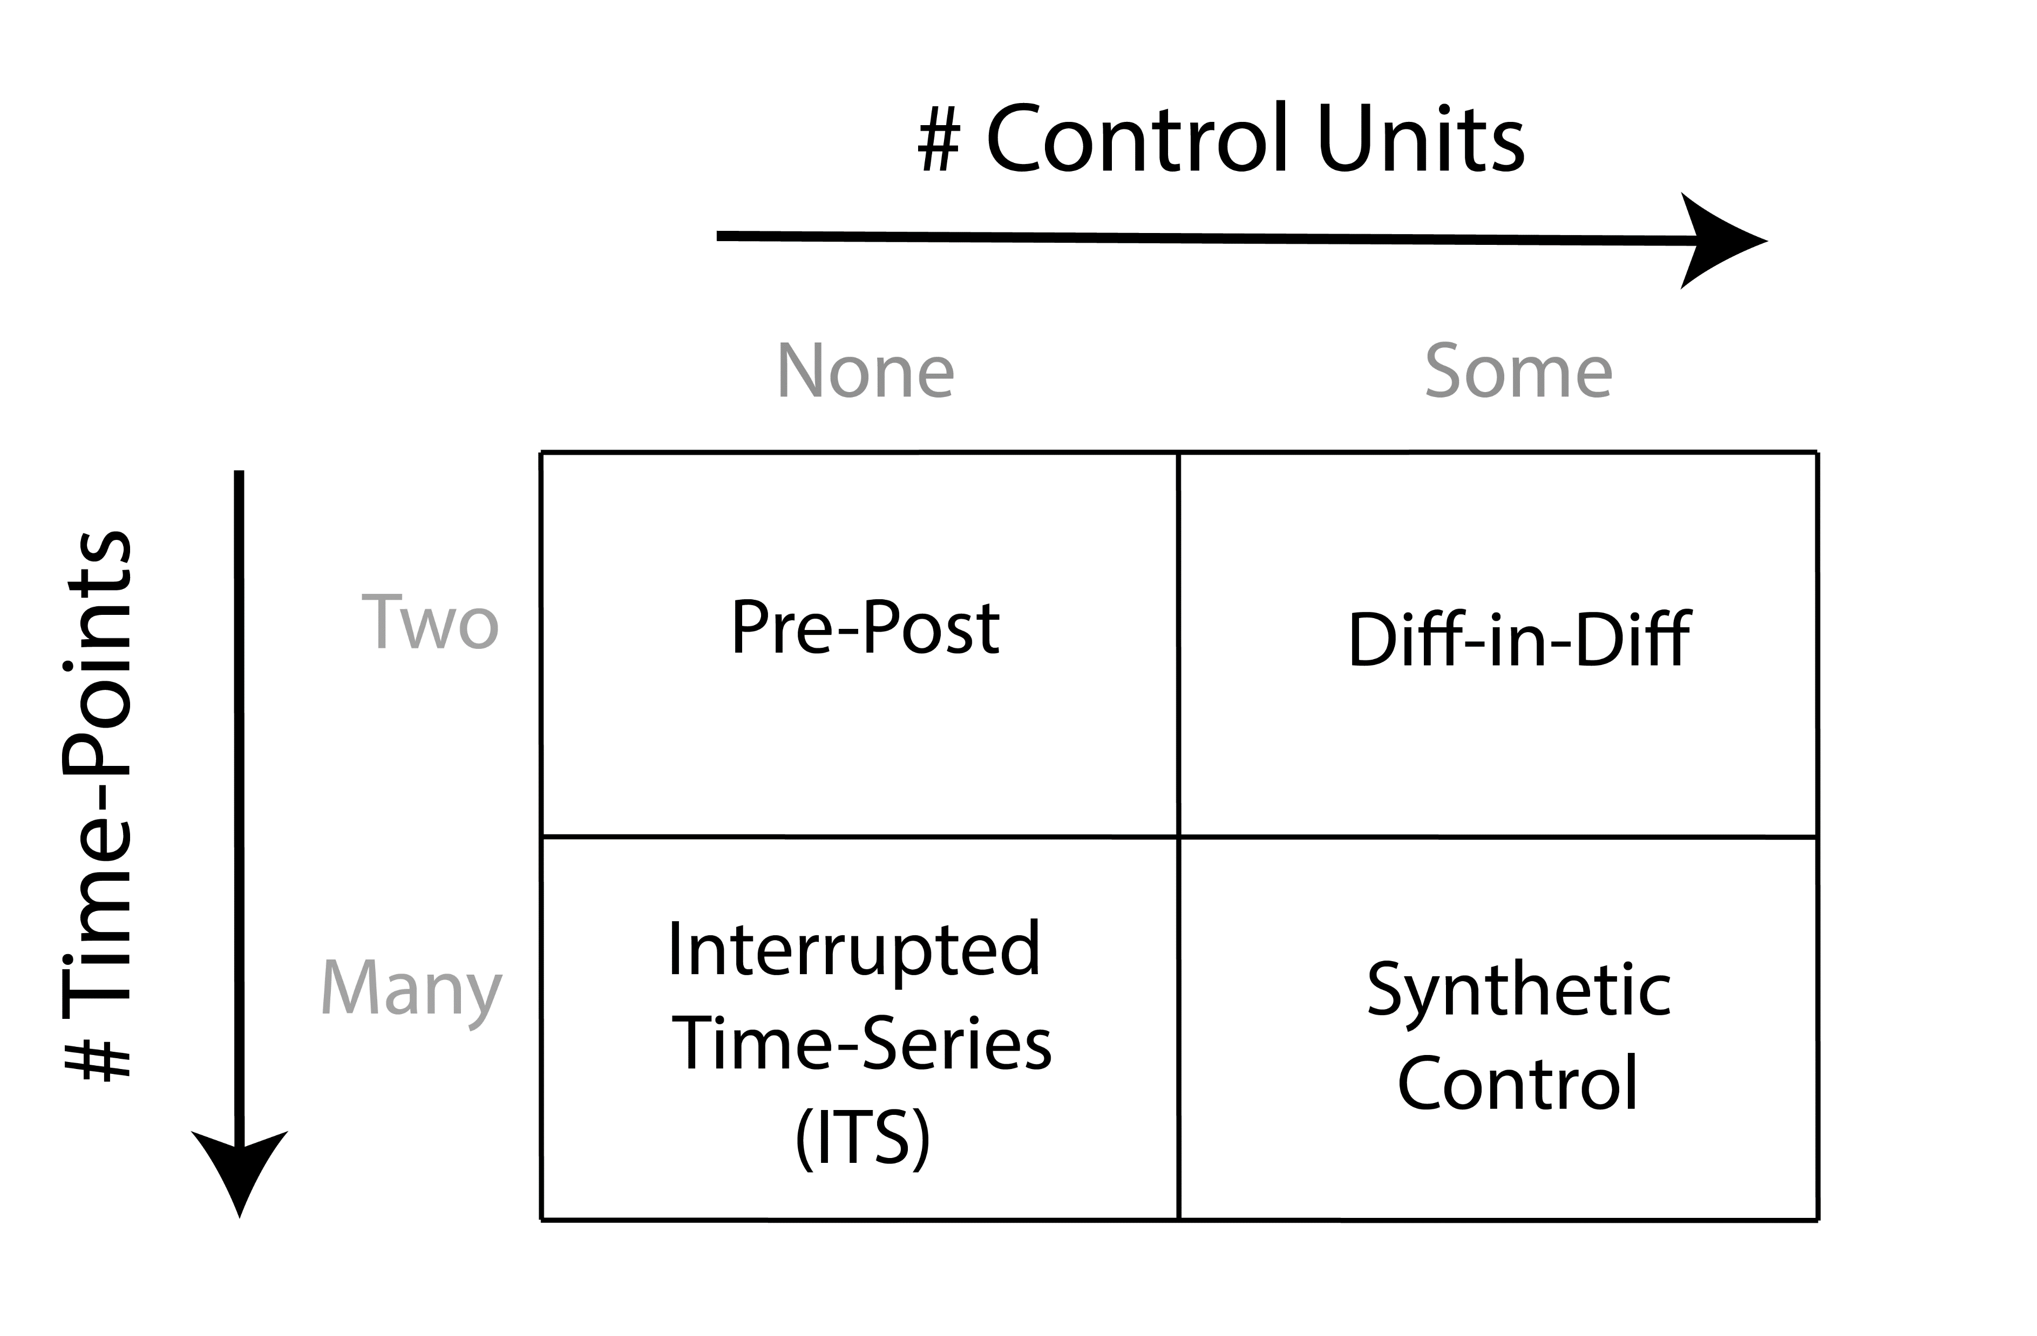

Slide 4
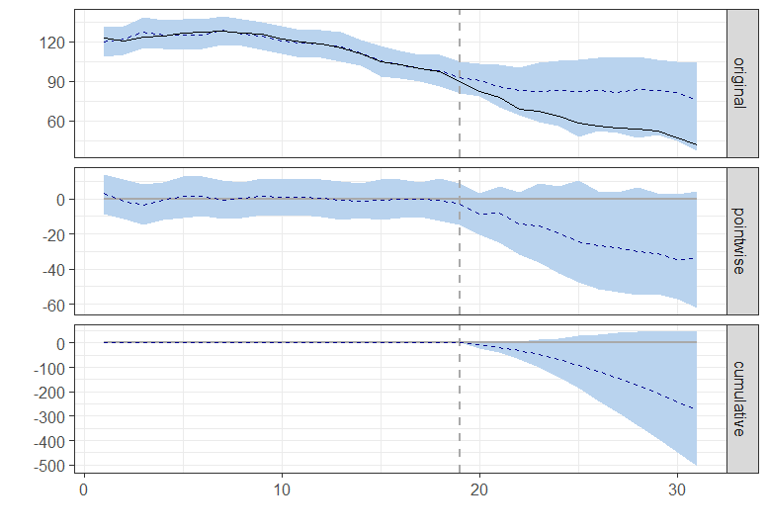
Combining ITS & Synth. Control
Controlled Interrupted Time Series
CausalImpact

Slide 5
Advanced Topics / Open Questions
How to deal with interventions which are not “sharp”?
E.g. policy may be gradually introduced / rolled out
Some policies may have an “anticipatory” effect; people stop smoking because cigarettes are about to get more expensive
Here fuzzy regression discontinuity type analyses may be helpful. OR explicit modelling of intervention effect.
How to deal with multiple treated units?
Aggregating vs not-aggregating
Classic approach is to take means, estimate ACE.
If you have enough data to perform, e.g., synthetic control analysis, may be better to first estimate unit-level effects, then summarize

Slide 6
Other dimensions to keep in mind
Interpretability of the model
Nice to know/ understand where inferences are coming from
Some methods better than others (e.g. synthetic control more understandable than CausalImpact)
Sensitivity / Robustness / Researcher Degrees of Freedom
How many arbitrary choices do you have to make?
How much do the results change if you make a different choice?
In practice, perform sensitivity checks whenever you can

Slide 7
So, which method should I use?

Slide 8
So which method should I use?
In this session we took a rather statistical view of this question
in part depends on type and amount of data
But this is the easy part
The answer in practice depends on domain knowledge
The hard part is to figure out which assumptions you need for causal inference and whether they are reasonable in your particular use case
It may simply not be possible in some cases!
E.g. DiD won’t work if trends are not parallel; synthetic control won’t work if there is interference between units (no matter how much data you have!)
Often, methods which are “data hungry” can relax some assumptions, but:
There is no free lunch!

Slide 9

Stay in touch!
e.vankesteren1@uu.nl
soda@odissei-data.nl
https://odissei-soda.nl
@SoDa_nl

Slide 10
Useful References
Difference in Differences
Angrist, J. D., & Krueger, A. B. (1999). Empirical strategies in labor economics. In Handbook of labor economics (Vol. 3, pp. 1277-1366). Elsevier.
Angrist, J. D., & Pischke, J. S. (2009). Mostly harmless econometrics: An empiricist's companion. Princeton university press.
Caniglia, E. C., & Murray, E. J. (2020). Difference-in-difference in the time of cholera: a gentle introduction for epidemiologists. Current epidemiology reports, 7, 203-211.
Interrupted Time Series
Bernal, J. L., Cummins, S., & Gasparrini, A. (2017). Interrupted time series regression for the evaluation of public health interventions: a tutorial. International journal of epidemiology, 46(1), 348-355.
Bernal, J.L, Cummins, S., & Gasparrini, A. (2019). Difference in difference, controlled interrupted time series and synthetic controls. International journal of epidemiology, 48(6), 2062-2063.

Slide 11
Useful References
Synthetic Control
Abadie, A., Diamond, A., & Hainmueller, J. (2010). Synthetic control methods for comparative case studies: Estimating the effect of California’s tobacco control program. Journal of the American Statistical Association, 105(490), 493-505.
Abadie, A. (2021). Using synthetic controls: Feasibility, data requirements, and methodological aspects. Journal of Economic Literature, 59(2), 391-425.
CausalImpact
Brodersen, K. H., Gallusser, F., Koehler, J., Remy, N., & Scott, S. L. (2015). Inferring causal impact using Bayesian structural time-series models. The Annals of Applied Statistics, 247-274.
Linden, A. (2018). Combining synthetic controls and interrupted time series analysis to improve causal inference in program evaluation. Journal of evaluation in clinical practice, 24(2), 447-453.
http://google.github.io/CausalImpact/CausalImpact.html

Slide 12
Useful References
Synthetic DiD
Arkhangelsky, D., Athey, S., Hirshberg, D. A., Imbens, G. W., & Wager, S. (2021). Synthetic difference-in-differences. American Economic Review, 111(12), 4088-4118.
More on Causal Policy Evaluation
Free online course materials made by Andrew Heiss
Program Evaluation for Public Service
https://evalf22.classes.andrewheiss.com/content/

